Slide 1

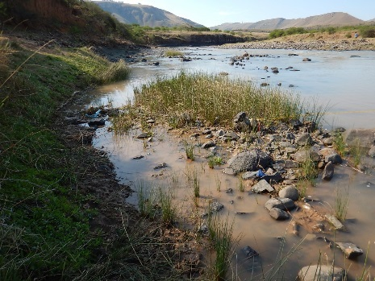

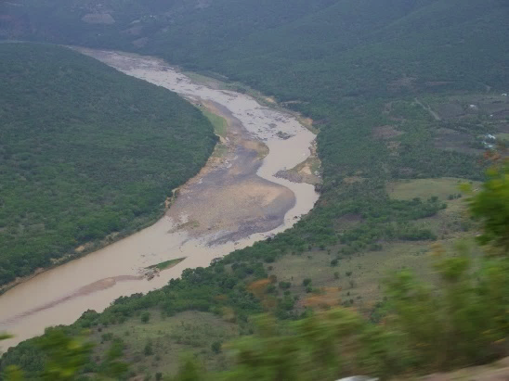
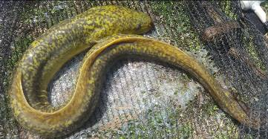
WP 11004: PSC MEETING 3,
13 FEBRUARY 2018
PRESENTATION TITLE
Presented by:
Name Surname
Directorate
Date
DETERMINATION OF WATER RESOURCE CLASSES AND RESOURCE QUALITY OBJECTIVES FOR THE WATER RESOURCES IN THE MZIMVUBU CATCHMENT:
PROJECT PROGRESS
Patsy Scherman

Slide 2
PROJECT PLAN
completed
in progress

Slide 3
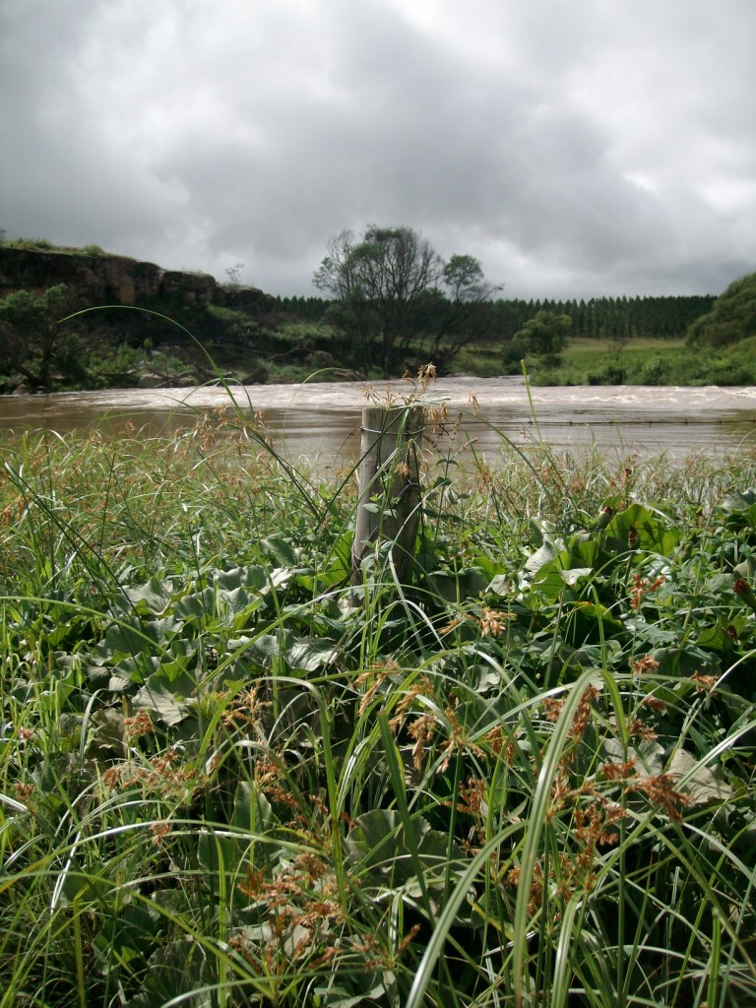
GENERAL PROGRESS

Slide 4
ACTIVITIES SINCE PSC 2, JULY 2017
EWR Estuary Report completed.
Phase 1 of scenario modelling and ecological consequences completed.
Motivation for additional modelling + scenarios when ProPlan data could not be accessed in time.
Phase 2 scenario modelling completed.
Consequences to scenarios completed. Reports currently under review.
Groundwater and wetlands components completed (other than RQOs): To be reported at PSC 4.
Feedback on Preliminary Classes to DWS HO at end Nov 2017, and RO in early Feb 2018.
Training workshop held in East London (focussing on Classes determination + RQOs): 5-9 Feb 2018.
Classes and Catchment Configuration Report initiated.

Slide 5
REPORTING STATUS
Inception Report
River survey Report
Status Quo/Delineation Report
Systems Modelling Report
River Desktop EWR Report
BHN Report
River EWR Report
Estuary EWR Report
Two workshop reports; one training report
Groundwater Report
Wetland Report
Scenario Description Report
Ecological Consequences Report
Additional results included as an Appendix to the Ecol Cons Report: Review underway
Non-Ecological Consequences Report: Review underway

Slide 6
PHASE 2 OF SCENARIO MODELLING
Background
WRP (based on 2014 Feasibility data) and Pro-Plan/AECOM (2017 Design phase) modelling different in terms of:
  Models used. WRYM=monthly model vs. Pro-Plan / AECOM daily model
  Different data lengths as input data
  Different Operating Rules NB
DWS intervention needed to get dam design + operational rules info from Pro-Plan, AECOM and the implementing agent, NWRIB.
Additional modelling undertaken mid-Sept to mid-Oct 2017. Scenario evaluation thereafter.

Slide 7
TASKS FOR ADDITIONAL MODELLING
Incorporate daily model operating rules into the monthly WRYM, and re-analyse scenarios as this will have an impact on the downstream EWR sites and Estuary, and Economic Analysis.
Test to ensure similar functionality and flow regimes at common points.
Scenario analysis undertaken iteratively for optimisation purposes.
Additional ecological consequences undertaken; followed on to Economic and Ecosystem Services consequences steps.

Slide 8
PHASE 2 SCENARIO MODELLING
Implications
Contract end date: Two month extension, so end July end September 2018.
Gazetting period: April – Sept 2018, rather than Feb – July 2018.
Reporting: Financial year deadlines should be met.
Public meetings: Provisionally last week May 2018.
Budget: No VO required. Budget reallocated.
Note
Recommended Catchment Configuration and Classes will be presented, but optimisation of the dam design and meeting of EWRs must be undertaken by the dam designers.

Slide 9
QUESTIONS FOR CLARIFICATION

